Slide 1
Examination of rumen fluid

Slide 2
Examination of rumen fluid
Indications
1. It is often essential to establish an accurate diagnosis of diseases of the rumen.
2. It is also essential when rumen fluid is collected for therapeutic transfaunation. (For
treatment of acidosis, simple indigestion, rumen stasis, stop rumination and
regurgitation).

Slide 3
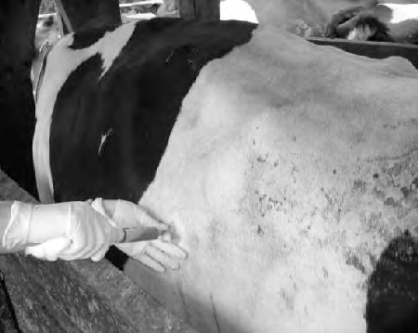
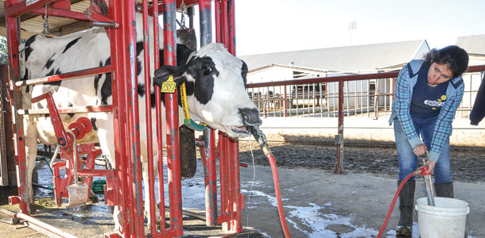
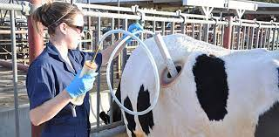
Methods of collection
1. Needle puncture of the rumen.
2. Oral or nasal passage of a collection tube is preferred to avoid risk of peritoneal
contamination from needle puncture.

Slide 4
(A) Physical characters
1. Color
A. Normal color varies depending on the nature of feed:
1. Olive color --------- Hay ration.
2. Deeper green color------------- Green ration
3. Yellowish brown color -------- Grain ration
B. Abnormal
1. Milky gray -------- Grain overfeeding
2. Darker greenish ------- Prolonged ruminal stasis and/or decomposition of rumen
contents.
3. Gray with clots of milk ------- Calves with abomasal reflux or esophageal groove failure.

Slide 5
2. Consistency
A. Normal
Slightly viscous consistency
B. Abnormal
1. Watery -------- Inactive bacteria and protozoa
2. Excess frothy -------- Tympany or vagus indigestion
3. Odor
A. Normal
I. Aromatic
B. Abnormal
1. Ammonia smell ------- Alkalosis
2. Moldy rotting odor ------ Protein putrefaction
3. Sour odor -------- Acidosis

Slide 6
(B) Chemical characters
1. pH
It is measured by universal pH papers indicators or by pH meters. It must be measured
immediately after sampling. Normal pH ranges between 6- 7 in animals on a mostly forage
diet but is lower at 5.5 - 6.5 in animals fed mostly grain.
Elevated pH (Rumen alkalosis)
Simple indigestion.
Urea indigestion.
Putrefaction of rumen ingesta.
Feeding on indigestible roughage.
Lowered pH (Rumen acidosis)
Engorgement with digestible carbohydrates.
Chronic rumen acidosis (pH 5 - 5.5).
Abomasal reflux from abomasal disease, vagal indigestion and intestinal
obstruction.

Slide 7
2.Sedimentation activity test.
It provides a rapid evaluation of microfloral activity.
Technique
1. Put a sample of rumen fluid in a test tube and let to stand.
2. Measure the time needed for completion of sedimentation of fine particles and
floatation of coarse solid particles
Normal time is 4 - 8 minutes.
Abnormal time
a. Very rapid sedimentation with no floatation occurs in:-
Rumen acidosis.
Prolonged anorexia.
Inactive microflora from indigestible roughages.
b. No appreciable sedimentation or floatation:-
Frothy bloat.
Some cases of vagal indigestion.

Slide 8
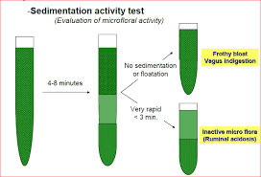

Slide 9
3. Methylene blue reduction test
It reflects the anaerobic fermentative metabolism of the bacterial population.
Technique
1. Mix 20 ml of rumen fluid with 1 ml of 0.03 % methylene blue in a test tube and let to stand at room temperature.
2. Measure the time needed for the color of the mixture to be changed.
3. Normal rumen fluid from cattle fed on hay and grain diet needs 3 min. to decolorize leaving a narrow ring of blue color at the top of decolorizing mixture.
4. Abnormal reduction of time up to 15 min. indicates:
Indigestible roughage.
Anorexia of several days.
Rumen acidosis.

Slide 10
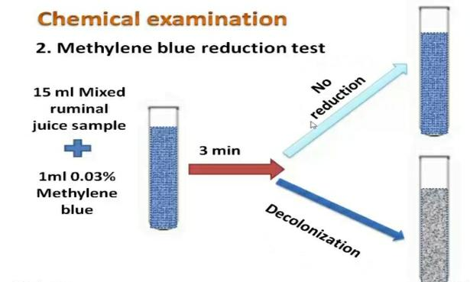

Slide 11
4. Cellulose digestion test. Technique
Indication :
This test were depend in the action of cellulitic bacteria (Ruminococcus bacteria break down the plant fiber into the monosaccharide glucose, which can then be further broken down through glycolysis)
Technique
1. Mix 10 ml of rumen fluid with 0.3 ml of 16 % glucose.
2. Immerse a thread of pure cellulose. The lower end is weighted by a glass bead.
3. Incubate the tube at 39 cº.
4. Record the time for the bead to be dropped free at the bottom of the tube.
Interpretation
A fully active rumen fluid will digest the cellulose foaming. Within 48 -
56 hours.
The test takes a long time and is not very accurate.

Slide 12
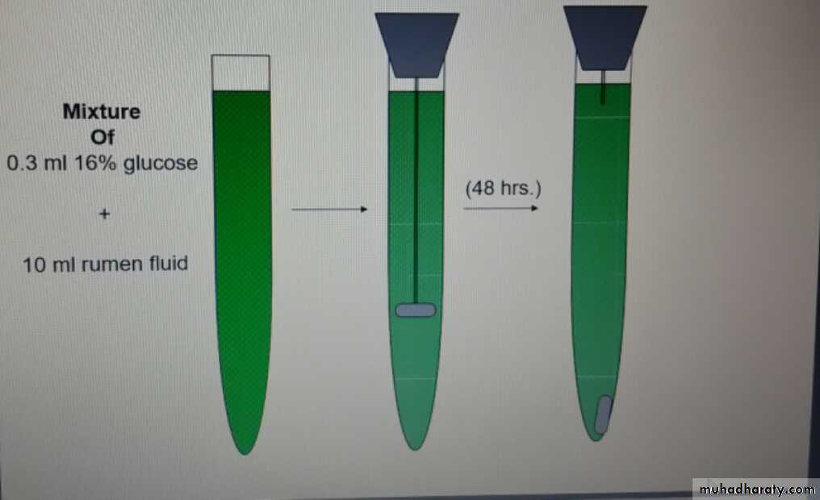
figure explain Cellulose digestion

Slide 13
5. Glucose Fermentation test
Technique
1. 0.5 ml of 16 % glucose solution is added to 10 ml of rumen fluid.
2. Place the mixture in a fermentation saccharometer and keep at 39 cº.
3. Read the result after 30 and 60 min.
Interpretation
The test measure indirectly the ability of microflora to breakdown (ferment) glucose
through measuring the volume of gas formed.
The normal rate of gas formation is 1-2 ml per hour.
If the microbial flora is inactive, little or no gas forms.
In foamy bloat more gas is formed with pronouncing foaming

Slide 14
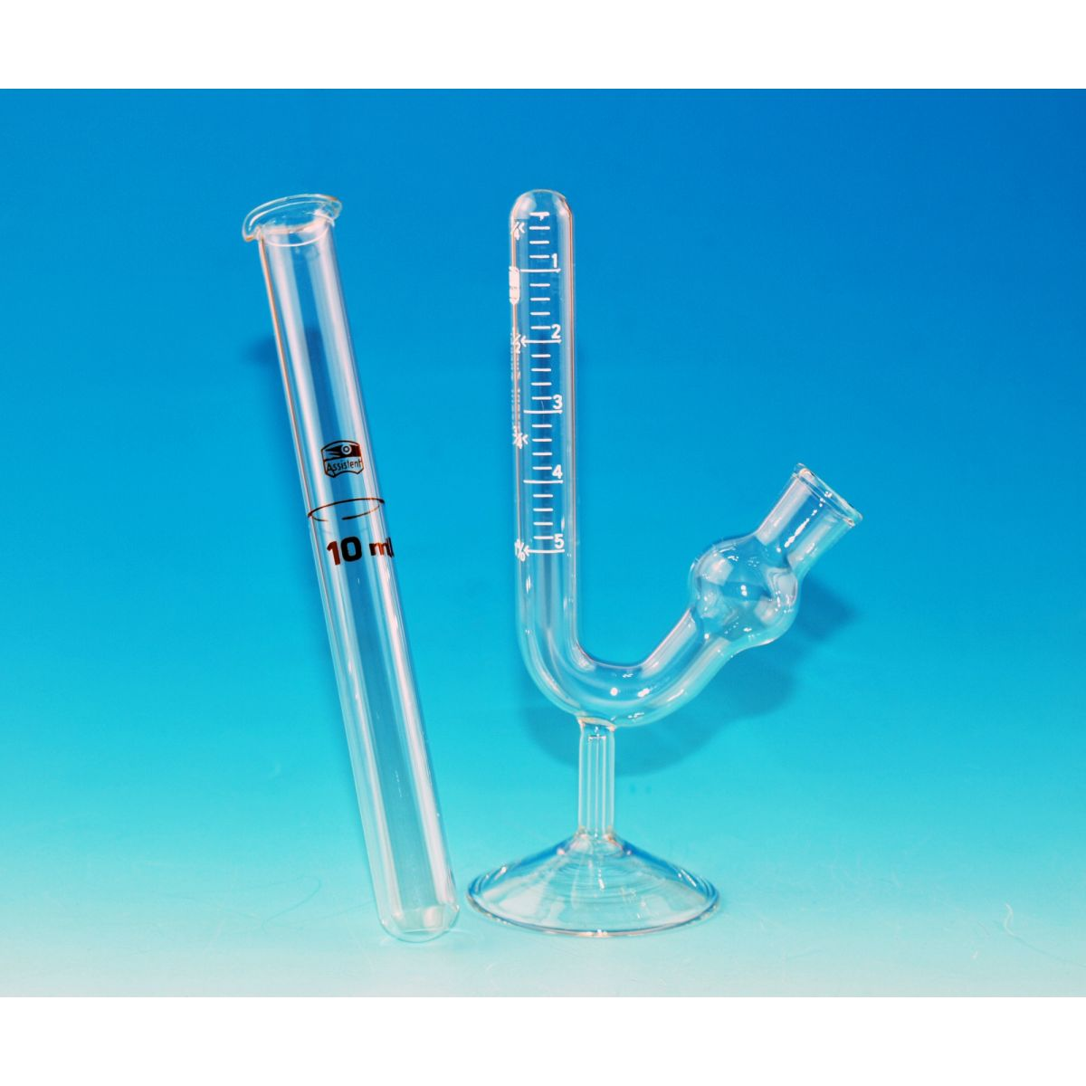

Slide 15
6. Nitrate Reduction test
It provides an idea about the activity of microbes to that reduce the nitrate.
Technique
1. Ten ml of sieved ruminal fluid is placed into each of three test tubes and 0.2, 0.5, 0.7 ml
of 0.025 % potassium nitrate solution is added to the three tubes.
2. Put the three tubes in a water bath at 39 cº.
3. Every five minutes one drop from each tube is placed in a small ceramic plate.
4. To each drop add 2 drops of reagent I (2 ml of sulphanilic acid in 30 % acetic acid to
make 200 ml) and 2 drops of reagent II (0.6 ml alpha-naphthylamine + 16 ml conc. acetic
acid + 140 ml distilled water)
5. Observe the change of color.
Interpretation
• Samples that contain nitrates are colored red.
• Rumen fluid of cattle fed a mixed ration will not change color after 5-10 min in tube
I and 20 min in tube II and30 min in tube III.
• Reduction is more rapid when cattle are fed green fodder or have ruminal
decomposition or bloat.
• Reduction is more slower when a deficient ration is fed or when the animal lacks
appetite.

Slide 16
(C) Examination for protozoa (fauna)
1. Qualitative examination
A. Motility
1. Is examined in a fresh film under low power magnifying microscope.
2. Motility is judged as follows:
+++ Highly motile and very crowded.
++ Motile and crowded.
+ Sluggish motility and low number.
No or sporadic alive fauna.

Slide 17
2. Quantitative evaluation of rumen fluid fauna. Technique
Strained rumen fluid sample.
Dilute 1 ml of strained sample with 15 ml saline solution and 5 ml lugols iodine
solution and shake gently.
Spread 0.1 ml of the mixture on glass slide in an area under cover glass of 22 X 50
mm.
Counting is carried out using low power (X 10). The field area of that lens is one
square millimeter.
Count 30 fields in the slide. The average count in 30 fields represents the protozoal
count over one square millimeter area of the field.
Multiply the average by 1100 to have protozoal count in 0.1 mm of the diluted fluid
which represents 0.02 ml of the original sample.
Multiply the obtained figure by 50 to obtain total protozoal count per ml.
(D) Bacteria
Gram staining
Gram stained smears from rumen fluid samples can be prepared. There are mainly Gram
negative bacteria in normal rumen fluid, but in ruminal acidosis Gram positive
streptococci and lactobacilli predominate

